Slide 1
Team Name : Logic Builders
Team Members Names | Engineering Specialisation | Graduating Year | College Names
Meghma Das | Information Technology | 2027 | MCKV Institute of Engineering
Argha Pal | Information Technology | 2027 | MCKV Institute of Engineering
BRILLIANCE@SCALE

Slide 2
Tell Us a Bit About Yourself
 | Meghma Das | Argha Pal
Any projects you've worked on | Movie Recommendation System, AI tutoring system for rural India, Meeting Schedular Agent | Movie Recommendation System, AI tutoring system for rural India, Health Coach Agent
Past Hackathon experiences | Smart India Hackathon 2024, Smart India Hackathon 2025, Infosys Global Hackathon 2025, Brain Dead 2k26 | Smart India Hackathon 2024, Smart India Hackathon 2025, Brain Dead 2k26
Accolades or awards received | NA | NA
Other details (If any) | NA | NA
BRILLIANCE@SCALE

Slide 3
Problem Statement 3: Driving Behavior Score
Solution Overview
Key Differentiators
RideIQ is a real-time two-wheeler driving behavior scoring system using low-cost sensor fusion (IMU + GPS) and a jerk-based scoring algorithm.
Context-aware scoring
(speed zone + road type)
Sensors:
MPU-6050 IMU + NEO-6M GPS + Barometer on ESP32
Kalman filter IMU+GPS
fusion for lean angle
Algorithm:
Weighted jerk-based scoring across 5 parameters
Jerk-based thresholds
(mathematically grounded)
Real-time:
Score updated every 5 seconds via BLE/Wi-Fi
Adaptive baseline learns
rider over first 5 trips
Cost:
Total Bill Of Material under ₹1,000 per unit
Output:
Dashboard, cloud log, insurance & fleet integration
No internet required
(edge inference on ESP32)
BRILLIANCE@SCALE

Slide 4
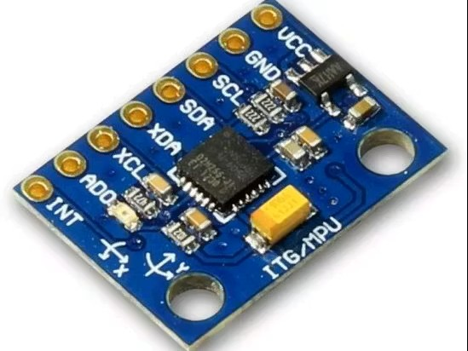
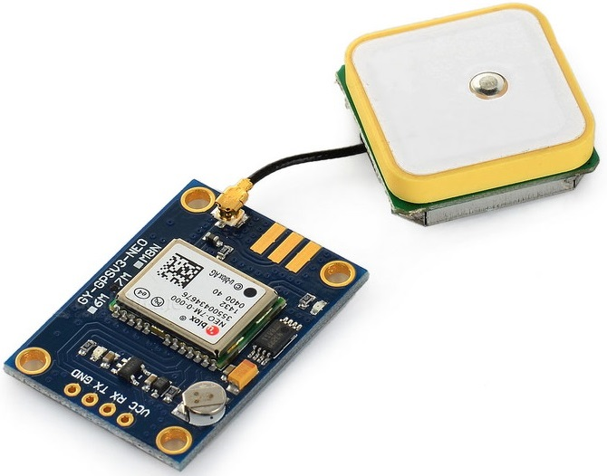
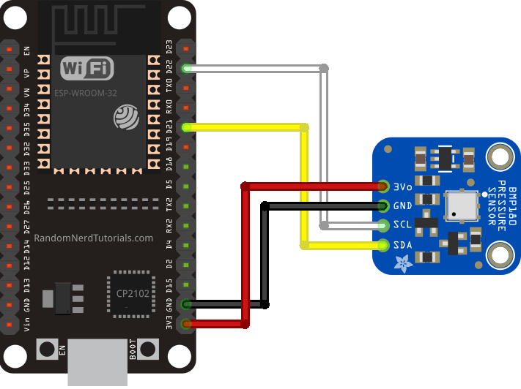
Sensors Details
A single chip combines three-axis accelerometer with three-axis gyroscope (6-axis) sensor. It uses I2C for communication via the address 0x68 (or 0x69 if the AD0 pin is set to true). It features an integrated Digital Motion Processor (DMP) that performs sensor fusion calculations to take the load off of the ESP32 and can provide quaternions directly as output. The IC runs on 3.3V to 5V power supply and can be connected to any of the 3.3V headers on the ESP32.
A u-blox GNSS receiver that provides output via NMEA 0183 sentences through the UART serial port with a default baud rate of 9600. It will provide approximately 2.5 m circular error probable (CEP) accuracy when there is an unobstructed view of the sky above. It requires a supply voltage of 3.3 V and a ceramic patch antenna (the antenna is typically soldered to it) oriented in a vertical position to receive signals from satellites to establish a position fix. Cold-start position fixes can take 30 to 60 seconds to establish.
When looking for a barometric altitude sensor, the BMP280 and MS5611 are two of the most common options. The BMP280 has a pressure sensing range between 300 and 1100 hPa and an altimetry resolution of approximately giving it a great general use sensor. The MS5611 has a wider range of pressure measurements and its altimetry resolution is significantly better than the BMP280 making it the preferable option for drones and higher precision applications. Both sensors can be connected to an MPU-6050 using I2C or SPI comms and also have a built-in temperature sensor in addition to measuring altitude through the use of the barometric formula. Because both sensors use unique I2C addresses, they can share I2C SDA and SCL lines with an MPU-6050 while all three sensors communicate on the same I2C network.
BRILLIANCE@SCALE

Slide 5
Design Details
Market Research & Literature Survey
• India has 300M+ registered two-wheelers; two-wheelers account for ~35% of all road fatalities (MoRTH 2023)
• Existing OBD-based systems (Mfine, Acko, Bajaj Allianz) work only for 4-wheelers; no affordable two-wheeler solution exists
• UBI (Usage-Based Insurance) market projected to reach $28B globally by 2027 — two-wheelers are an untapped segment
Working Principle & Scoring Formula
Score = 100 − Σ (penaltyᵢ × weightᵢ) where jerk J = dA/dt (m/s³) | lean angle θ = ∫ gyro_z dt − GPS_heading_correction
Parameter | Trigger Threshold | Weight | Score Penalty
Harsh braking | J < −15 m/s³ | 25% | −10 per event
Hard acceleration | J > +12 m/s³ | 20% | −8 per event
Sharp cornering | θ > 35° | 25% | −10 per event
Speed limit violation | >120% of limit | 20% | −5 per km
Lane stability | Lateral jerk > 8 | 10% | −3 per event
BRILLIANCE@SCALE

Slide 6
Design Details — Algorithm Logic Flow Diagram
End-to-end data flow: from raw sensor input to final driving behavior score
IMU
GPS
Baro
MPU-6050
Accel + Gyro
100 Hz
NEO-6M
Speed + Heading
10 Hz
BMP280
Altitude + Incline
25 Hz
Kalman Filter — Sensor Fusion
Merges IMU + GPS to estimate: velocity, lean angle θ, jerk J = dA/dt | removes noise & GPS lag
Brake detect
Corner detect
Accel detect
Context Engine
J < −15 m/s³
→ HarshBrake event
θ > 35°
→ SharpCorner event
J > +12 m/s³
→ HardAccel event
OSM road class
Speed zone tag
Time of day
Weighted Scoring Engine
Score = 100 − Σ(penaltyᵢ × weightᵢ)
Brake 25% · Accel 20% · Corner 25% · Speed 20% · Stability 10% → Score 0–100 (updated every 5 s)
BRILLIANCE@SCALE

Slide 7
Design Details — System Architecture & Benchmarking
Benchmarking vs existing solutions
Hardware block diagram
Feature | RideIQ | Others
2-wheeler specific | ✓ | ✗
Works offline | ✓ | ✗
Lean angle tracking | ✓ | ✗
Cost < ₹1,000 | ✓ | ✗
Real-time alert | ✓ | Partial
Context-aware scoring | ✓ | ✗
Jerk-based (not G-force) | ✓ | ✗
MPU-6050
IMU
NEO-6M
GPS
BMP280
Baro
UART
I²C / SPI
ESP32
MCU
BLE/WiFi
LED
Alert
Wi-Fi
Cloud
BLE
App
BRILLIANCE@SCALE

Slide 8
Logic Flow Diagram — Real-Time Scoring Pipeline
Data acquisition
Processing
Scoring engine
Output
IMU — MPU-6050
Kalman Filter
Braking Score
Weighted Sum
Ax, Ay, Az @ 100Hz · Gx, Gy, Gz
Fuse IMU + GPS, reduce noise/drift
Penalty = f(|J|, freq) wt=25%
S = 100 − Σ(pᵢ×wᵢ)
GPS — NEO-6M
Jerk Computation
Acceleration Score
Adaptive Baseline
Lat/Lon, Speed, Heading @ 10Hz
J = ΔA/Δt (m/s³) per axis
Penalty = f(|J|, freq) wt=20%
Calibrate to rider over 5 trips
Barometer — BMP280
Lean Angle Est.
Cornering Score
Score = 0–100
Altitude Δ → road incline %
θ = ∫Gz dt − GPS heading corr.
Penalty = f(θ, G-force) wt=25%
Updated every 5 seconds
Context DB (OSM)
Event Detector
Speed Score
BLE → Rider App
Road class · Speed limit zone
Threshold crossing → event flag
Penalty = f(v/limit) wt=20%
Live score + trip summary
Context Tagger
Stability Score
MQTT → Cloud
Speed zone + road class lookup
Penalty = f(lateral J) wt=10%
Log, insurance, fleet dash
Score < 40 → Buzzer Alert
BRILLIANCE@SCALE

Slide 9
Major Risks & Mitigation
RISK:
IMU drift over long rides
High
✓ Kalman filter with periodic GPS re-calibration every 60s
RISK:
False positives on speed bumps / potholes
Medium
✓ Barometer + accelerometer Z-axis filter distinguishes road anomalies from braking
RISK:
GPS signal loss in urban canyons
Medium
✓ Dead reckoning using IMU integration maintains scoring continuity for up to 30s
RISK:
Battery drain on ESP32
Low
✓ Deep sleep mode between events; duty cycle reduces power to <80mA average
RISK:
Rider behavior varies by region/road type
High
✓ Adaptive baseline + OSM-based road context engine normalizes scoring per road class
BRILLIANCE@SCALE

Slide 10
Business Potential
₹4,200 Cr+
300M+
35%
₹1,000
India UBI market
(2026E)
Registered 2-wheelers
in India
Road fatalities
from 2-wheelers
Hardware Bill Of Material
per unit
Revenue Model & Market Segments
B2B — Insurance Companies
UBI premium discounts drive rider adoption; insurers pay ₹50–100/month per device subscription
B2B — Fleet Operators (Zomato, Swiggy, Dunzo)
Reduce accident liability; driver score used for bonuses & training
B2C — Rider Safety App
Freemium app; premium tier at ₹99/month unlocks detailed trip analysis
B2G — Smart City / Traffic Dept
Aggregate anonymized data for hotspot analysis and road safety policy
BRILLIANCE@SCALE

Slide 11
Plan & Budget Needed
Prototype Development Milestones
Month 1
Month 2
Month 3
Month 4
Month 5
Hardware Setup
Algorithm Dev
Field Testing
App & Cloud
Validation
ESP32 + IMU + GPS assembly; basic data logging
Kalman filter + jerk detection; MATLAB simulation
Real-ride data collection; threshold calibration
BLE app; MQTT cloud dashboard; UX testing
Benchmarking vs existing; accuracy report
Budget Required for Prototype
Item | Estimated Cost
Hardware (ESP32, IMU, GPS, barometer ×3 units) | ₹3,500
PCB fabrication & enclosure (weatherproof) | ₹4,000
Cloud hosting (AWS IoT / Firebase — 6 months) | ₹2,500
App development (React Native) | ₹0 (in-house)
Testing & field data collection | ₹2,000
Contingency (10%) | ₹1,200
TOTAL | ₹13,200
BRILLIANCE@SCALE

Slide 12
VARROC eureka CHALLENGE
Thank You
Team Logic Builders | Problem Statement 3: Two-Wheeler Driving Behavior Score
BRILLIANCE@SCALE

